Slide 1
Scenario : (Json Transformation)
I like big bugs and I cannot lie
Jatin Bansal Aaryan Sharma
Tanveer Sodhi

Slide 2
Problem Statement
Create an Application that can do below
Accept a source JSON structure
Accept a target JSON structure
Accept a mapping (provided in a CSV format)
Build an app that will generate the code required to transform the source JSON structure to target JSON structure based on the mapping[Key Feature]
The generated code should preferably be Python or NodeJS.
If you are using any transformation libraries like JQ/JSONATA/JOLT to achieve the mapping and transformation, the application should auto generate the spec files needed for these libraries [Key Feature]
Application should be generic enough to accept different source/target/mapping inputs and dynamically arrive at the required code to do the conversion.

Slide 3
Softwares Used
Node Express Server
JSONata
CSV Parser

Slide 4

JSONata
JSONata is a lightweight query and transformation language for JSON data.
It requires a specification string and sourceJson code to convert it to the target JSON.
The specification string is built by our application according to the provided input mapping.csv file.

Slide 5
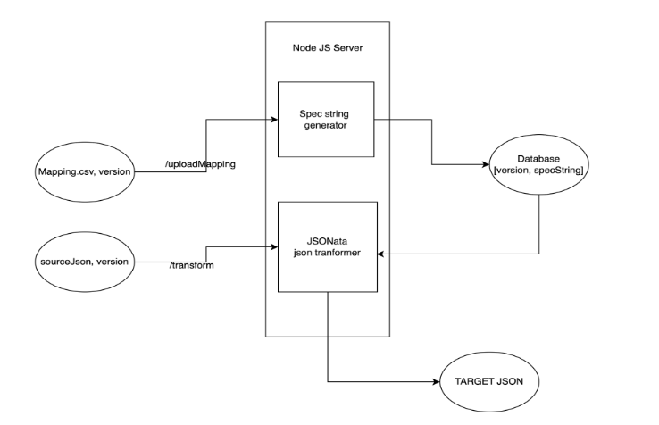
Architecture

Slide 6
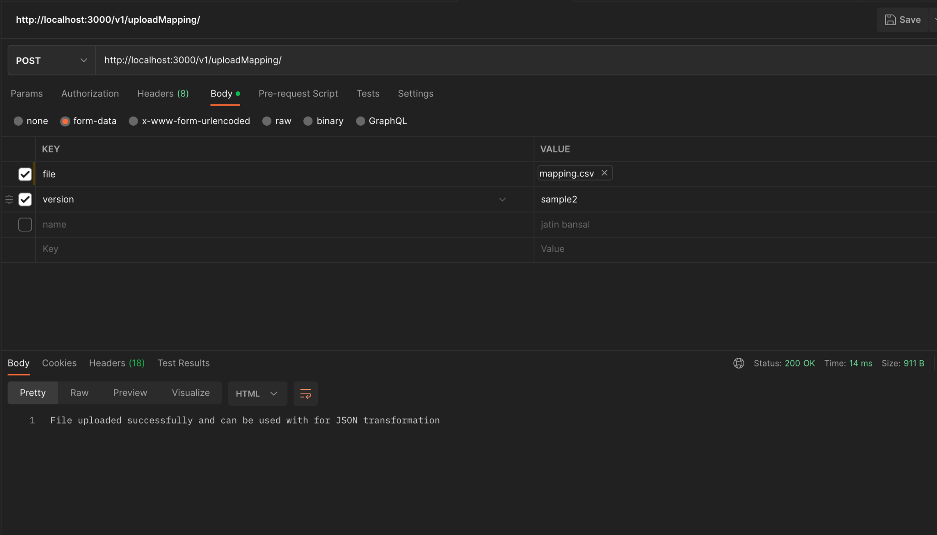
Sample ScreenShots

Slide 7
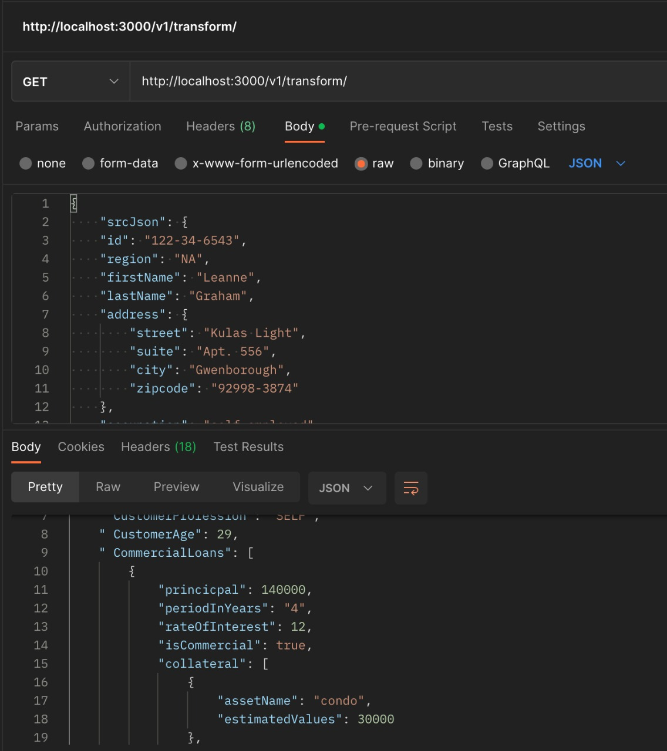
Sample ScreenShots

Slide 8
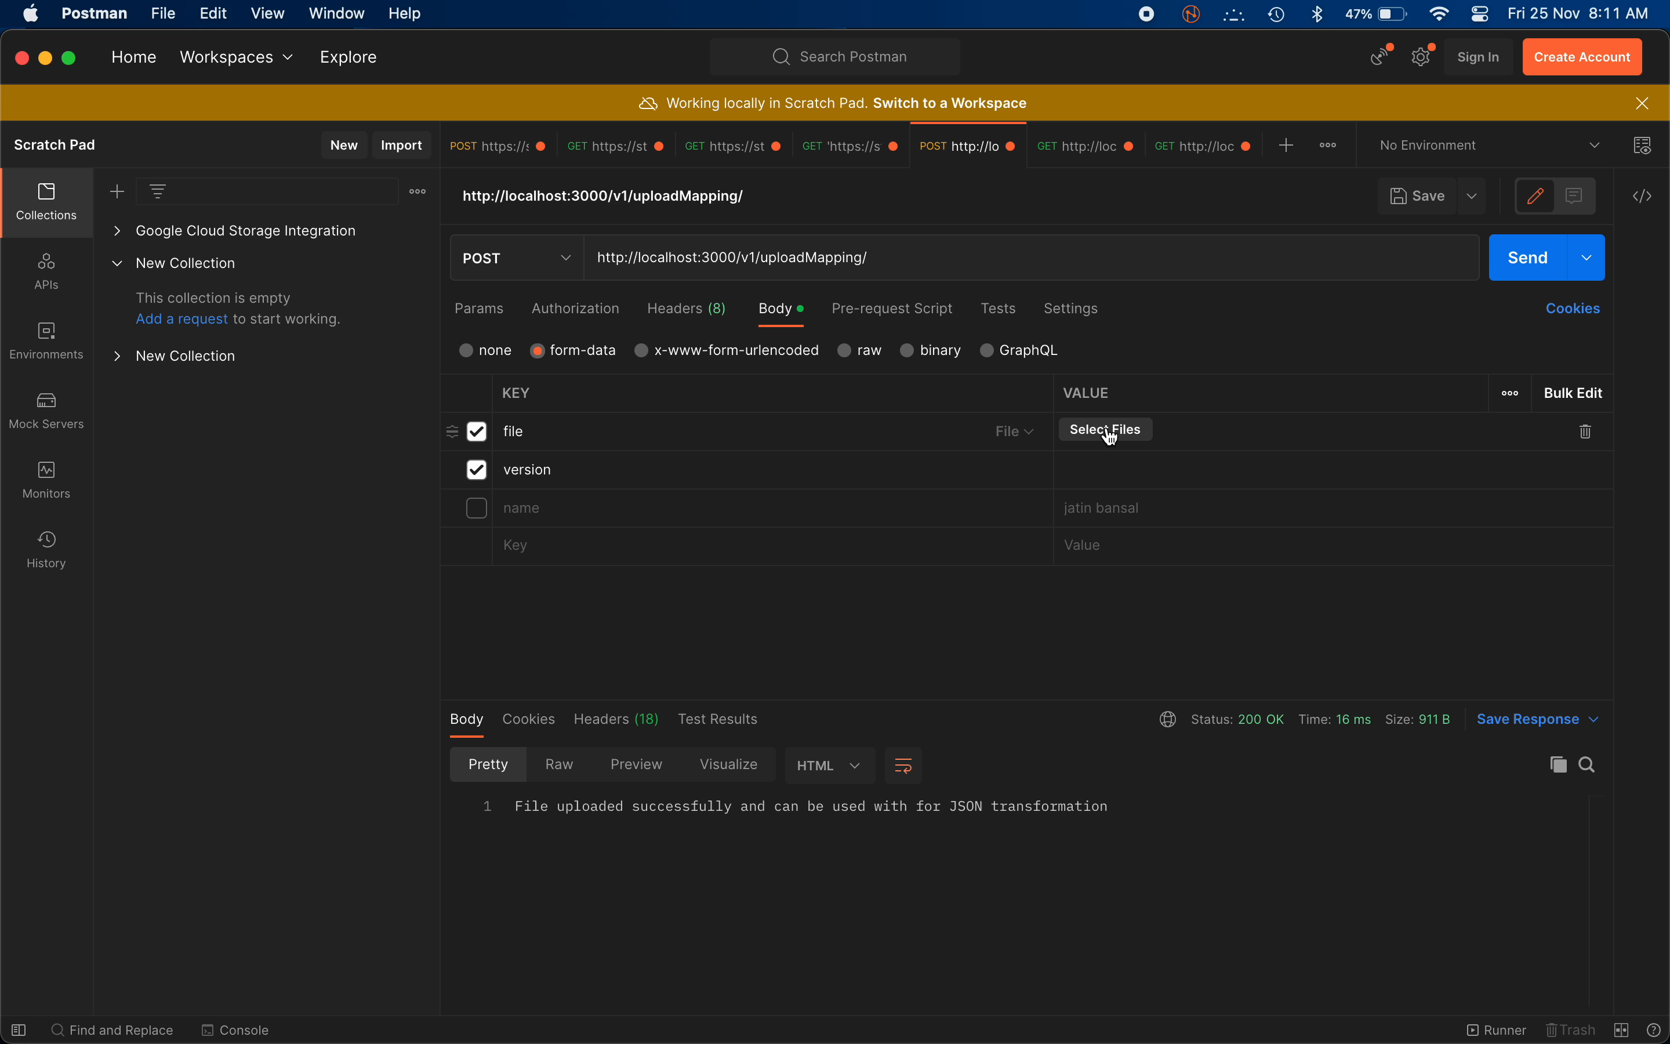
Demo Video

Slide 9
Thank You !

